Slide 1


Slide 01
What is Agent Architecture?
The Structural Blueprint Behind Autonomous Systems
DEFINITION
REAL-LIFE ANALOGY
🏢
Agent Architecture is the software design framework that dictates how a Large Language Model (LLM) integrates with Memory, Tools, and Planning modules to autonomously solve multi-step problems.
Think of a corporate office. To run efficiently, you need more than just raw intelligence; you need a structured operational blueprint:
• LLM (CEO / Brain): Makes the high-level decisions.
• Managers (Planners): Sequence tasks and manage timelines.
• Workers & File Cabinets (Tools & Memory): Execute and retrieve data.
Framework
Integration
Autonomy
SYSTEM FLOW
MONOLITHIC VS. AGENTIC
Monolithic (Chat): Direct single-turn text output. Fast but constrained to training data and simple reasoning paths.
Input
Brain
Planner
Tools
Output
Architected (Agent): Multi-step, iterative loops utilizing active memory, self-correction, and API tool integrations.
Flow dynamic: The brain decides objectives, the planner sequences execution paths, and specialized tools execute the final steps to produce output.
Upgrades an LLM from a text generator to an autonomous system.
Architecture upgrades an LLM from a text generator to an automated problem-solving system.
Structuring the flow: The brain decides, the planner sequences, the tools execute.

Slide 2

Slide 02
Agent Architecture Overview
Understanding the structural foundation.
Before exploring patterns, we must define the standard components of an agent.

Slide 3





Slide 03
Core Components of an Agent
Profile / Persona
Reasoning Engine
The system prompt defining the agent's Role, Goal, and Backstory (e.g., "You are an expert Data Analyst").
The core LLM responsible for processing inputs, evaluating states, and generating logical next steps.
Memory Module
Tool Integration
Storage for past context. Includes Short-term (current conversation) and Long-term (vector databases).
The standardized interfaces allowing the LLM to trigger external APIs, run code, or query databases.
An agent is simply an LLM wrapped in structured memory and actionable tools.

Slide 4









Slide 04
The Architecture Landscape
Frameworks
Tools
Memory
Planning
LangChain, CrewAI, AutoGen orchestrate the flow.
Search, Calculators, Custom APIs.
Redis, Pinecone, local JSON histories.
ReAct, Plan-and-Solve, Tree of Thoughts.
Modern architecture requires assembling discrete, modular components around the LLM.

Slide 5
Slide 05
Monolithic vs. Agentic Architecture
How shifting to modular design changes system capabilities.
Feature | Monolithic LLM (ChatGPT) | Agentic Architecture
Information Source | Static Training Data | Live API / Database Tools
Task Completion | Single turn response | Iterative, multi-step execution
Error Handling | Hallucinates confidently | Self-corrects via Evaluators
Role | Assistant / Oracle | Autonomous Worker
Agentic systems trade speed for accuracy, reliability, and real-world impact.

Slide 6
Slide 06
Why Architecture Matters
warning_amberThe Problem with Prompts
Relying solely on "Mega-Prompts" (huge blocks of text telling the AI what to do) creates fragile systems.
If the task requires logic, math, and coding, a single prompt forces the LLM to juggle too much context, leading to context degradation and errors.
schemaThe Architectural Solution
By splitting logic into discrete components (Planner, Executor), we isolate context.
The Planner only sees the goal. The Executor only sees the specific sub-task. This Separation of Concerns drastically improves LLM accuracy.
Good architecture reduces the cognitive load on the LLM at any given step.

Slide 7
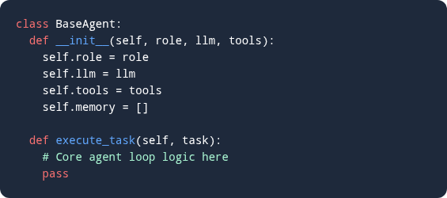
Slide 07
Basic Agent Class Structure
Understanding the object-oriented approach to building agents.
BaseAgent Class Structure (Python)
The Core State Container
At its core, an Agent is essentially a class instance that manages context between LLM calls, holding three vital properties:
LLM Reference: The cognitive brain powering decisions.
Allowed Tools: The specific APIs and capabilities enabled.
Conversation History: The memory context of the interaction.
infoFramework Abstraction Note
Production frameworks like LangChain and CrewAI abstract this class boilerplate away from you, allowing you to focus purely on prompt strategy and tool definition.
At the code level, agents are classes that manage the state between LLM calls.

Slide 8

Slide 08
Design Pattern 1: Planner - Executor - Evaluator
The foundational triad of robust autonomous tasks.
Splitting execution into three distinct phases guarantees higher quality outputs.

Slide 9





Slide 09
The P-E-E Triad
1. Planner
2. Executor
3. Evaluator
Decomposes the main user goal into a sequential list of smaller, achievable sub-tasks.
Takes one sub-task at a time, uses tools to perform the work, and returns raw results.
Reviews the Executor's output against the original sub-task goal to ensure accuracy.
This pattern separates strategy (planning) from tactical labor (execution) and QA (evaluation).

Slide 10

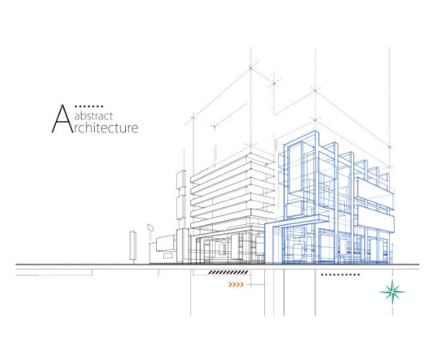
Slide 10
Zoom In: The Planner
The Planner is usually a highly capable LLM (like GPT-4) prompted specifically to think abstractly.
•
Input: High-level user prompt.
•
Process: Creates a Directed Acyclic Graph (DAG) or a simple linear list of steps.
•
Output: JSON array of sub-tasks.
Why it's needed: LLMs get confused if asked to write code, test it, and deploy it all in one prompt.
The Planner creates the map; it does not walk the path.

Slide 11
Slide 11
Zoom In: The Executor
Receive Task
Select Tool
Accepts a strictly defined sub-task from the Planner (e.g., "Search Wikipedia for Python").
Reviews available tools and determines which API or script is required.
Execute
Return Data
Generates the required JSON payload and triggers the external tool system.
Passes the raw output back to the central system for evaluation.
Executors are tactical; they focus entirely on the mechanics of tool usage.

Slide 12
Slide 12
Zoom In: The Evaluator
The Evaluator acts as the Quality Assurance (QA) gate. This prevents cascading errors where one bad API call ruins the entire agent run.
1
2
3
Checks
Did the Executor actually fulfill the Planner's sub-task?
Handles Errors
If an API failed, it commands the Executor to retry.
Approval
Only upon approval does the system move to the next planned step.
Evaluators are the safety net that makes autonomous loops reliable for enterprise use.

Slide 13

Slide 13
Design Pattern 2: The ReAct Pattern
Reasoning and Acting interleaved.
ReAct is the most famous prompting strategy for giving LLMs agency.

Slide 14
Slide 14
The ReAct Loop Elements
Thought
Action
The LLM verbalizes its reasoning (e.g., "I need to find the current CEO of Apple.")
The LLM calls a specific tool (e.g., `Search[Apple CEO]`)
Observation
Repeat or Conclude
The external tool returns the result (e.g., "Tim Cook") back into the prompt context.
The LLM repeats the Thought/Action process until it can generate a Final Answer.
Forcing the LLM to output a "Thought" before taking an "Action" vastly improves tool selection accuracy.

Slide 15
Slide 15
ReAct Prompt Template
The exact prompt structure that powers ReAct agents.
System Prompt
Predictable LLM Outputs
This strict formatting forces the LLM to output predictable text blocks. A Python script parses this output, executes the tool, and injects the "Observation" back into the prompt.
# Answer the question as best you can. # You have access to: [Search, Calc]
Use the following format:
Question: {input}
Thought: you should always think about what to do
Action: the action to take
Action Input: the input to the action
Observation: the result of the action
... (this can repeat N times)
Final Answer: the answer to the original input
Execution Loop
Thought
Reasoning
➔
Action
Tool Call
➔
Observation
External Data
ReAct is essentially a highly structured text-parsing game between the LLM and your code.

Slide 16
Slide 16
Standard Prompting vs ReAct
Why ReAct outperforms simple Q&A for complex tasks.
Metric | Standard Chain of Thought (CoT) | ReAct (Reason + Act)
Information Limits | Limited to training weights | Pulls live data via actions
Hallucination Risk | High (if guessing facts) | Low (relies on external Observations)
Error Correction | Fails silently | Can retry if Observation is empty
Use Case | Creative writing, logic puzzles | Web research, API operations
ReAct grounds the LLM's reasoning in external, factual reality.

Slide 17

Slide 17
Design Pattern 3: The Tool-Use Pattern
Giving the LLM digital hands.
Tools bridge the gap between text generation and real-world system state changes.

Slide 18

Slide 18
How LLMs Interact with Tools
LLMs cannot "click" buttons or "run" Python natively. They can only output text.
•
Function Calling: Modern models (GPT-4) are trained to output valid JSON that matches a tool's parameters.
•
The Execution: Your application framework intercepts this JSON, runs the actual API, and feeds the text response back.
The LLM is the brain deciding what function to call; your server does the calling.
Tool use relies entirely on the LLM's ability to format outputs strictly as requested JSON.

Slide 19
Slide 19
Common Tool Types
search
Search Engines
Tavily, Google Search, Wikipedia integrations for real-time fact retrieval.
calculate
Math / Interpreters
Python REPL or Calculator tools to solve math problems without hallucination.
dns
Data APIs
Connecting to CRM, SQL databases, or internal HR systems via REST APIs.
Tools should be highly specific and single-purpose to avoid confusing the LLM.

Slide 20
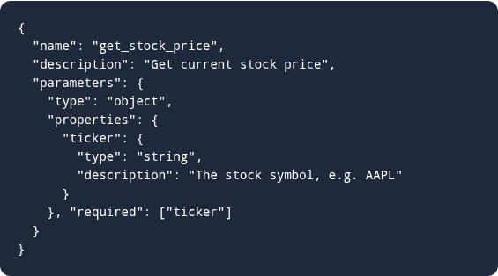
Slide 20
Defining a Tool Schema
You must teach the LLM exactly how to use the tool via descriptions.
The Description field is the most critical part of this schema.
The LLM reads this text to decide whether to trigger this specific tool or a different one depending on the user query.
Pro Tip
Treat tool descriptions as mini-prompts.
Warning: Poorly described tools lead to LLMs using the wrong tool or providing incorrect parameters.

Slide 21

Slide 21
Design Pattern 4: Reflection
Teaching agents to critique their own work.
Reflection loops significantly boost performance in code generation and complex writing.

Slide 22

Slide 22
What is Reflection?
Reflection is an architectural pattern where an agent (or a secondary "Critic" agent) reviews the initial output before delivering it to the user.
•
Drafting: The Generator agent creates V1.
•
Critique: The Critic agent evaluates V1 against the prompt constraints and flags errors.
•
Revision: The Generator receives the critique and creates V2.
LLMs are often better at finding errors in text than they are at generating perfect text on the first try.

Slide 23
Slide 23
Zero-Shot vs Reflection
Zero-Shot (Direct Generation)
Process
Prompt → Generate → Output
Pros
Fast, cheap (consumes fewer tokens).
Cons
High failure rate on complex constraints (e.g., "Write exactly 500 words with no adjectives").
Reflection Architecture
Process
Prompt → Draft → Critique → Revise → Output
Pros
Substantial improvement in logical consistency, code correctness, and constraint adherence.
Cons
Slower, costs more API tokens.
Use Reflection for high-stakes outputs (like code or contracts) and Zero-Shot for simple Q&A.

Slide 24
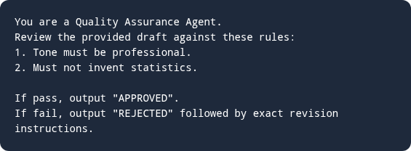
Slide 24
Implementing a Critic Agent
Setting up the dual-agent interplay.
Actionable Feedback Loop
By providing the Critic agent with explicit, numbered rules, the generator agent receives highly actionable feedback to fix its mistakes automatically.
check_circle
Rule-Based Evaluation
Critic evaluates drafts against strict, deterministic constraints (e.g., tone guidelines, factual compliance).
autorenew
Automated Iteration
Outputs are structured as binary pass/fail states with precise revision instructions for the next draft.
The Critic prompt should contain the strict evaluation criteria that the initial generator might miss.

Slide 25

Slide 25
Hands-on Case Study: Recruiter Agent Design
Applying architectures to automate talent sourcing.
Real-world agent design requires combining P-E-E, Tool Use, and Reflection patterns.

Slide 26
Slide 26
The Recruiter Agent Workflow
01
02
03
04
Ingest Job Description
Source Candidates (Tools)
Evaluate Resumes (Reflection)
Draft Outreach (Execution)
Agent receives a raw PDF or text link for an open Data Scientist role.
Uses LinkedIn API or internal DB tools to search for matching profiles.
Scores resumes against the JD. A Critic agent verifies the scoring logic is unbiased.
Generates personalized outreach emails for the top 5 candidates.
Complex enterprise workflows map perfectly to the Planner-Executor-Evaluator architecture.

Slide 27

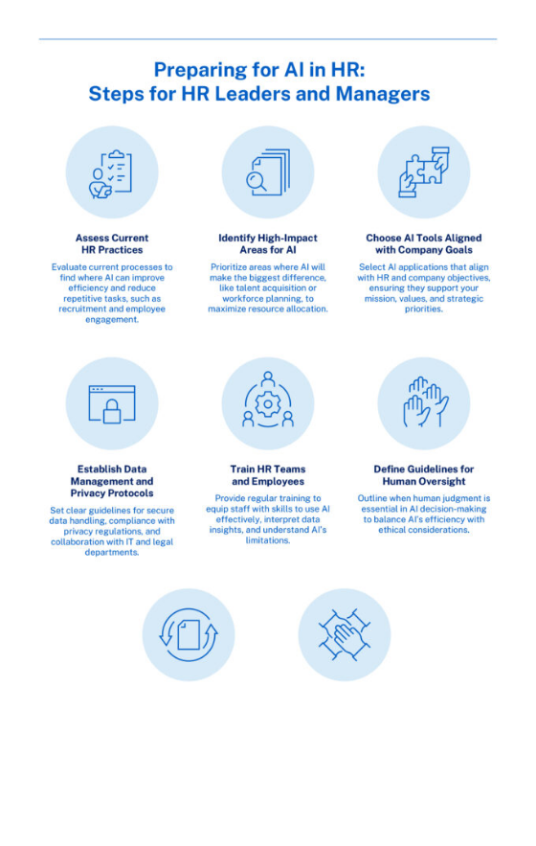
Slide 27
Candidate Sourcing (Planner & Tools)
How the ReAct pattern is utilized in step 2:
THOUGHT
"I need to find Data Scientists with PyTorch experience in London."
ACTION
LinkedIn_Search_Tool
ACTION INPUT
{"title": "Data Scientist", "skill": "PyTorch", "location": "London"}
OBSERVATION
Tool returns 15 profile URLs.
The agent acts as an automated boolean search expert, dynamically adjusting queries based on results.

Slide 28

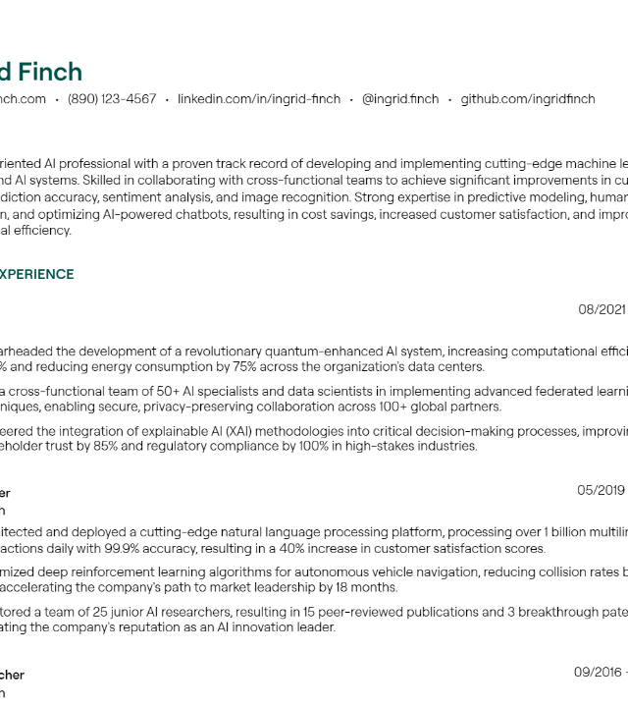

Resume Evaluation (Reflection)
Once resumes are retrieved, the architecture uses the Reflection pattern to ensure fairness.
AGENT 1: SCORER
Analyzes Resume A and assigns a 90% match, citing deep ML experience.
AGENT 2: CRITIC
Reviews Agent 1's logic: "REJECTED. You ignored the requirement for 5 years of team management. Adjust score."
This dual-agent setup prevents hallucinated qualifications and ensures strict adherence to the Job Description.
Multi-agent reflection provides built-in compliance and QA.

Slide 29
Slide 29
ROI of the Recruiter Agent Architecture
Why companies invest in Agentic HR solutions.
Metric | Manual Human Recruiter | Agentic Architecture
Sourcing Speed | 2-4 hours per role | 5 minutes via APIs
Resume Screening | Prone to fatigue / bias | Consistent, objective scoring criteria
Outreach Drafting | Templates (Impersonal) | Highly personalized per candidate
Scalability | Limited by headcount | Infinite parallel processing
Agents don't replace HR; they replace the manual data-gathering, allowing HR to focus on interviews.

